Slide 1
Rule-based Systems
IE562 Computational Foundations of Smart Systems
Juxihong Julaiti
Sep, 2018

Slide 2
Outline
Rule-based Systems
Forward and Backward Chaining
Packer
Identifier
PyKown
Homework

Slide 3

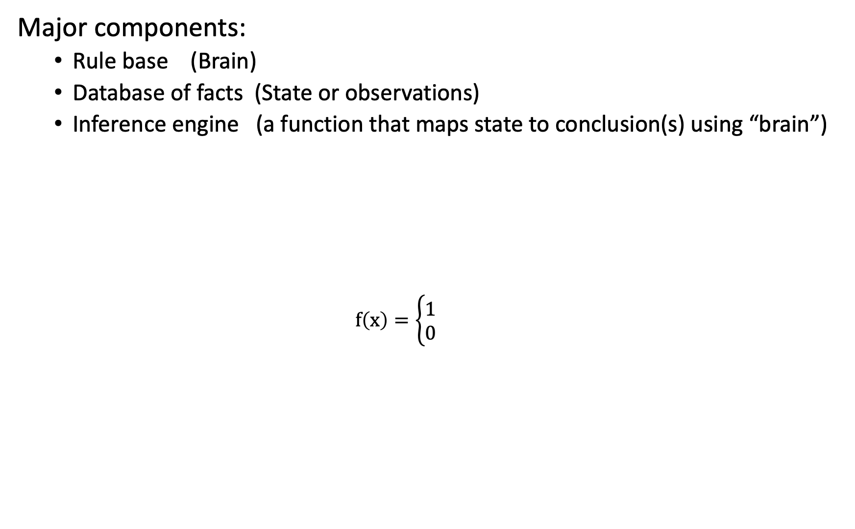
Rule-based Systems
Major components:
Rule base (Brain)
Database of facts (State or observations)
Inference engine (a function that maps state to conclusion(s) using “brain”)
$$f\left(x\right)=\left\{\begin{aligned}1 \\ 0\end{aligned}\right.$$
RBS: facts->conclusions via. a match-resolve-act cycle
Similar to a mathematical function
Or mathematical proofs:
Given conditions, expand the conditions, until goal is reached
$$f\left(x\right):ℝ→[0,1]$$
x>=0
x<0

Slide 4
Forward and Backward Chaining
FC
Start from facts (LHS)
Check rules (RHS)
If LHS matches RHS (triggered): execute the action (fired), update the LHS
If the goal is reached: stop
else if: LHS is not updated, stop
else: check rules
BC:
Start from hypothesis
Check facts:
If facts support the hypothesis: stop
If need to check another hypothesis: check facts against it
Else: stop

Slide 5
Packer
Observations/facts/state:
Suitcase content
Suitcase space size
Mound
Essentials
Articles
Article size
Mate
Step (checking or putting)
Rule base:
6 rules, see the lecture note
Inference engine:
match-resolve-act cycle

Slide 6
Identifier
Observations/facts/state:
If each of the hypothesis/evidence is true or unknown
Final hypothesis
Intermediate hypothesis
Evidences
Rule base:
10 rules, see the lecture note
Inference engine:
match-resolve-act cycle

Slide 7
PyKown and Homework
PyKnown: Check notebook and documentation
Homework: Will be sent out tonight

